Slide 1
Attendance system for faculty using facial recognition
-Team CodeHers

Slide 2
Stepwise development
Detecting face
Posing and Projecting Faces
Encoding faces
Finding person’s name from the encoding
Details in database- Name and Time

Slide 3
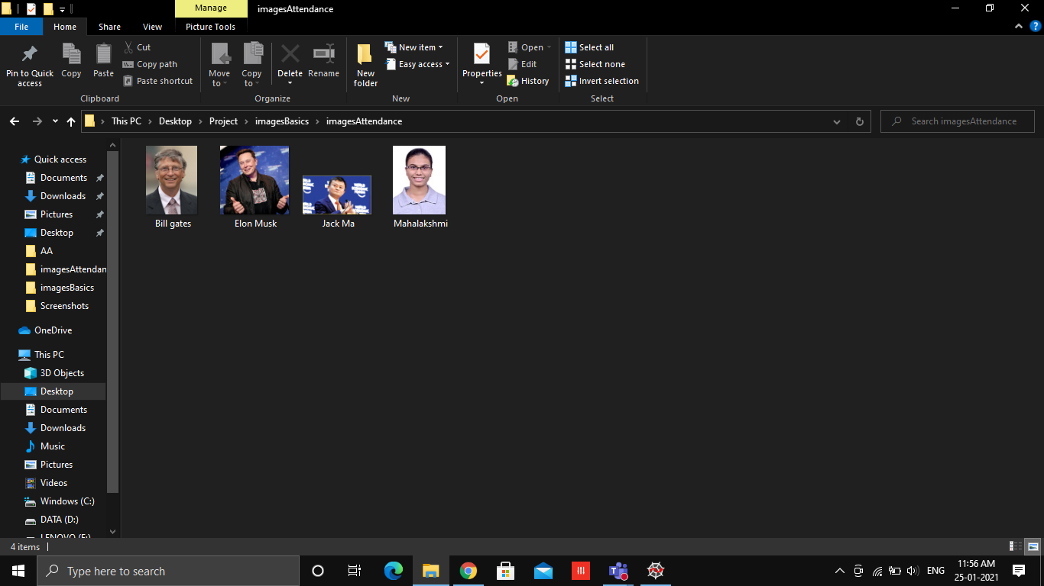

Slide 4
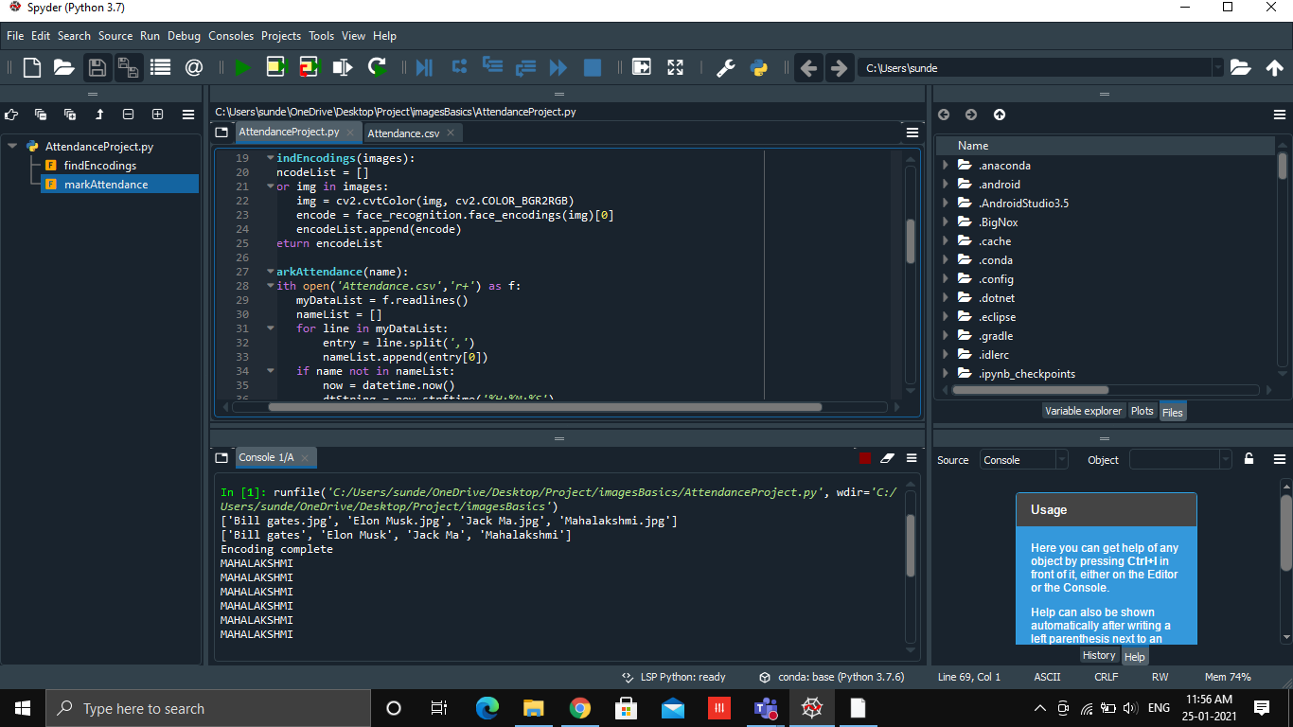

Slide 5
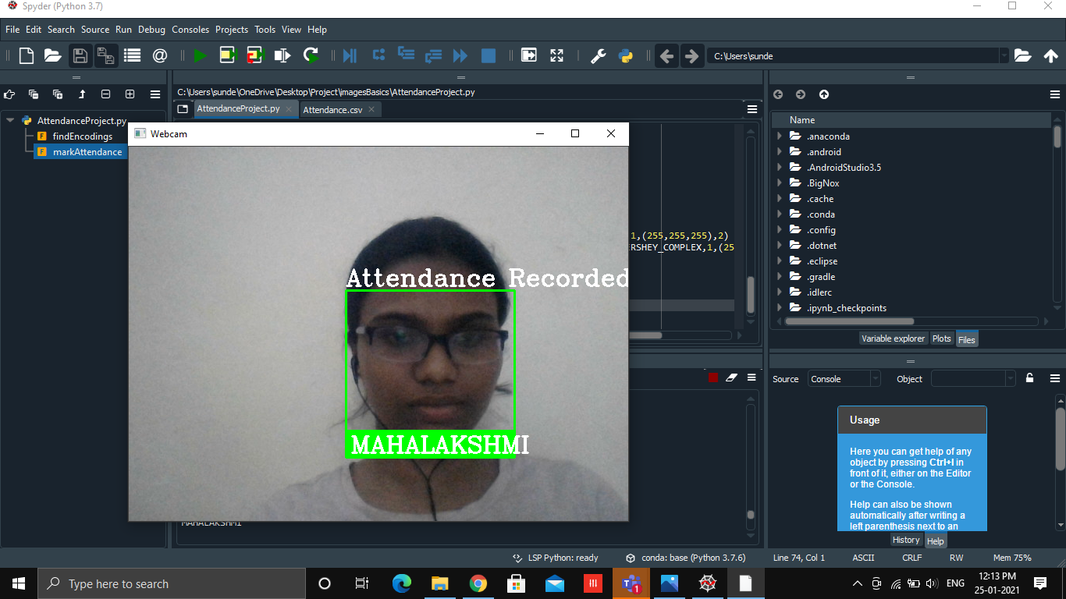

Slide 6
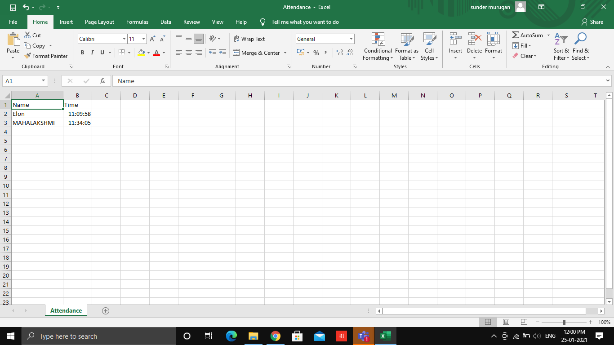

Slide 7
Thank you

